Slide 1

MUSIC STORE DATA ANALYSIS

Slide 2
About US
Group member 1: K. Dileep, B. Tech in CSE
ID: , Batch: 448
Group member 2: K. Nikshith, B. Tech in CSE
ID: , Batch: 448
Group member 3: M. Lakshmikar, MBA
ID: , Batch: 448

Slide 3
Objective of the Project
To analyze a Music Store database using SQL
To understand and apply relational database concepts
To extract business insights from raw data
To practice joins, aggregations, and subqueries
To improve real-world SQL data analysis skills

Slide 4
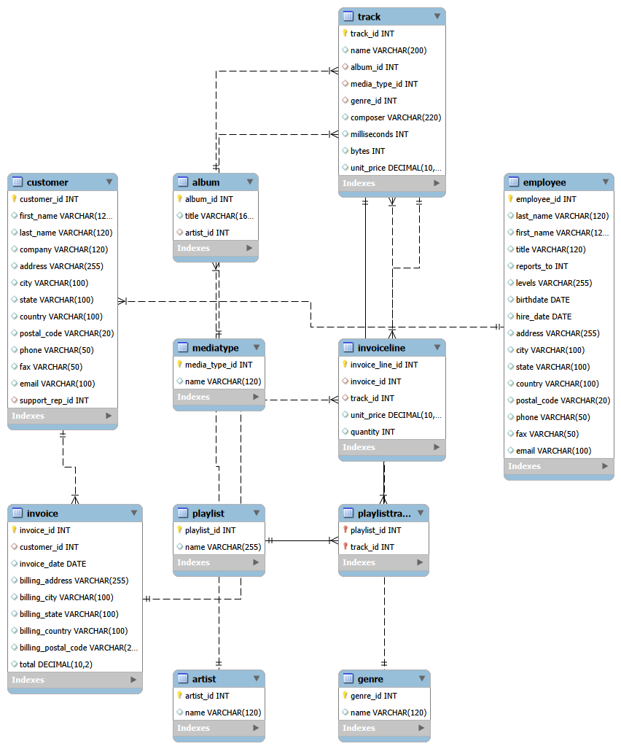
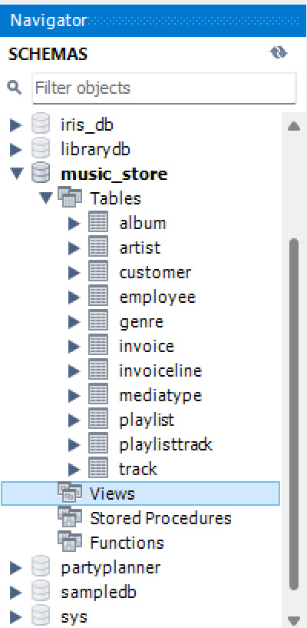
ER Diagram and Schema Explanation

Slide 5
ER Diagram and Schema Explanation
The Music Store Database follows a Relational Schema Design
Key Tables
Employee – Stores employee details and hierarchy
Customer – Stores customer information
Invoice – Records purchase transactions
InvoiceLine – Stores individual track purchases
Track – Contains song details
Album – Groups tracks under albums
Artist – Stores artist information
Genre – Classifies music genres

Slide 6
ER Diagram and schema explanation
The Music Store Database follows a Relational Schema Design
Relationships
One customer can have multiple invoices
One invoice can have multiple invoice lines
Each track belongs to one genre and one album
Each album is linked to one artist

Slide 7
Key analysis questions (use cases) The questions were centered around
Employee Hierarchy Analysis.
Geographical Invoice Distribution.
High-Value Transactions.
Revenue by City.
Best Customer Identification.
Genre-Based Customer Preferences (Rock Listeners).
Top Rock Artists by Track Count.
Track Duration Analysis.
Customer Spending by Artist.
Most Popular Genre by Country.
Top-Spending Customer by Country.

Slide 8
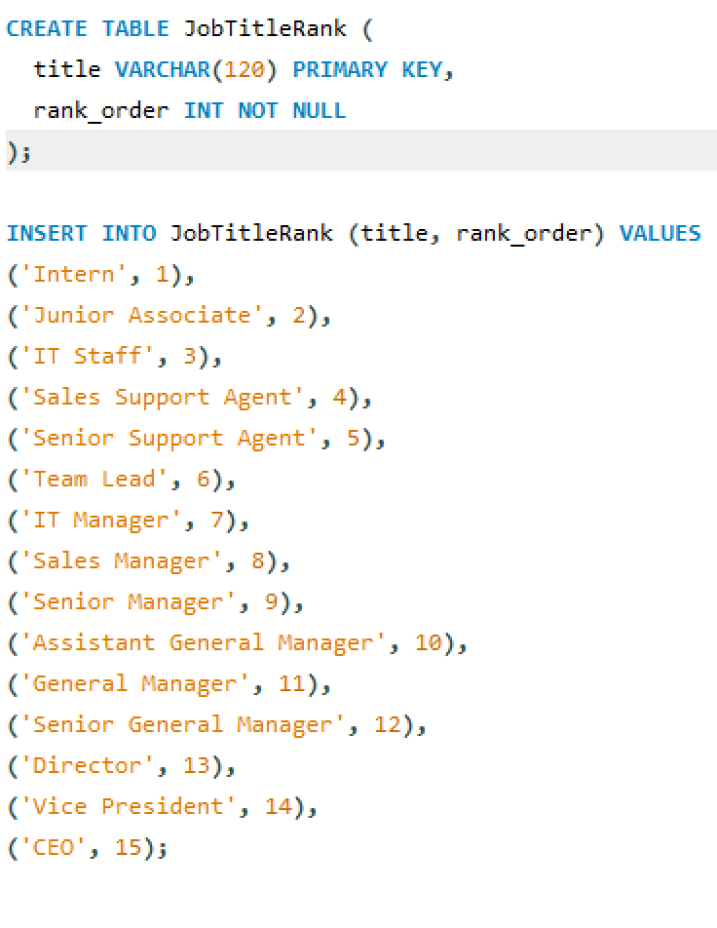
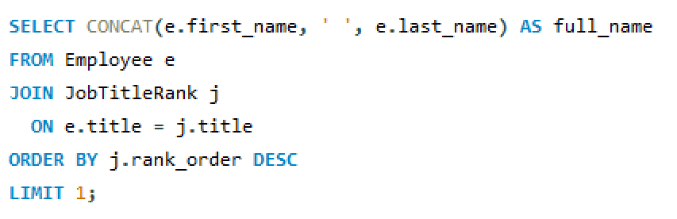
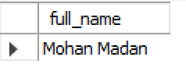
SQL query results with screenshots or summaries
1. Who is the senior most employee based on job title?

Slide 9
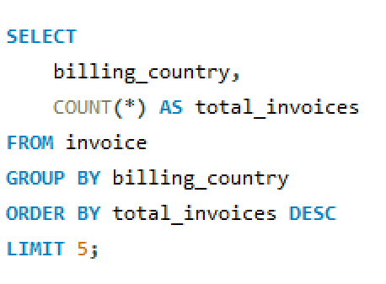
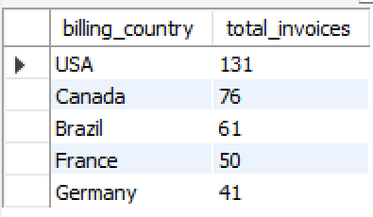
2. Which countries have the most Invoices?

Slide 10
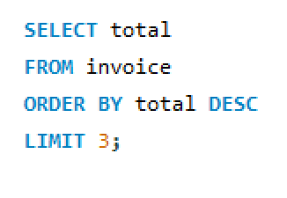
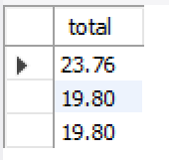
3. What are the top 3 values of total invoice?

Slide 11
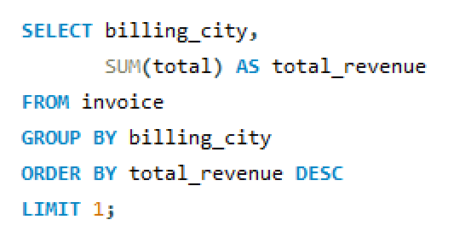
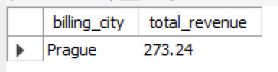
4. Which city has the best customers? - We would like to throw a promotional Music Festival in the city we made the most money. Write a query that returns one city that has the highest sum of invoice totals. Return both the city name & sum of all invoice totals.

Slide 12
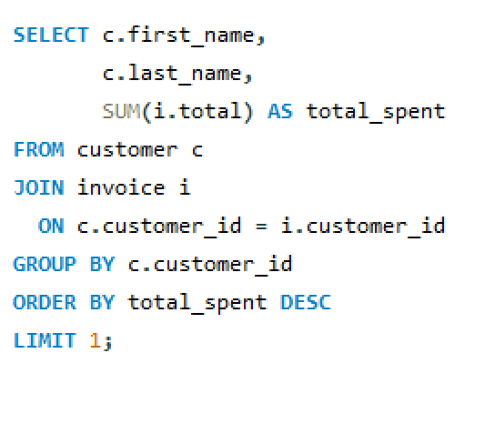

5. Who is the best customer? - The customer who has spent the most money will be declared the best customer. Write a query that returns the person who has spent the most money.

Slide 13
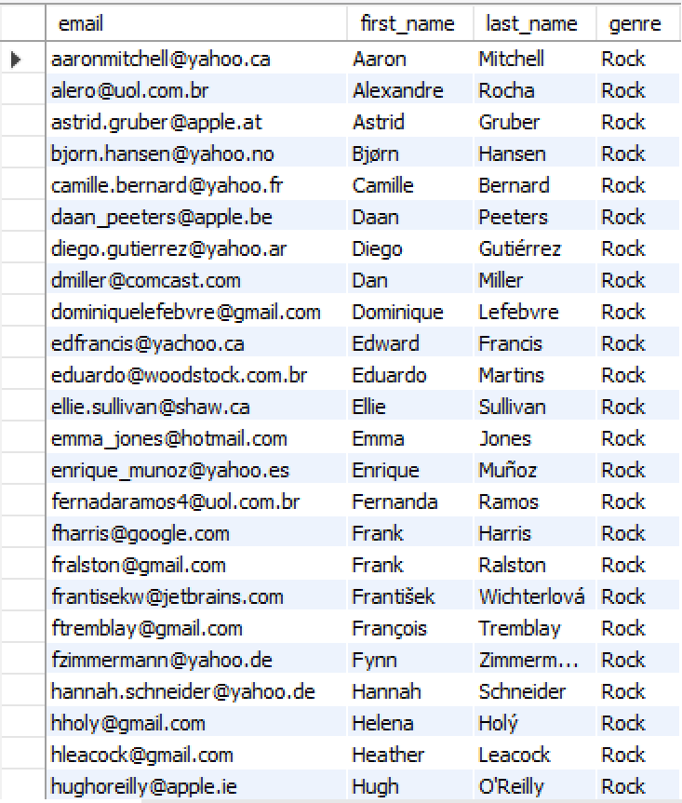
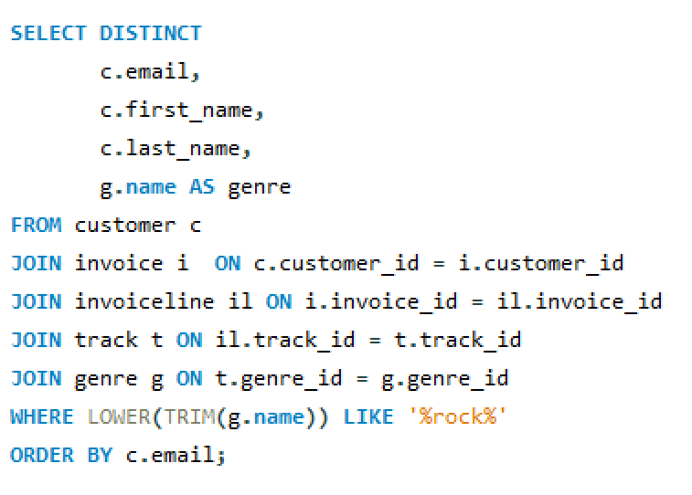
6. Write a query to return the email, first name, last name, & Genre of all Rock Music listeners. Return your list ordered alphabetically by email starting with A.

Slide 14
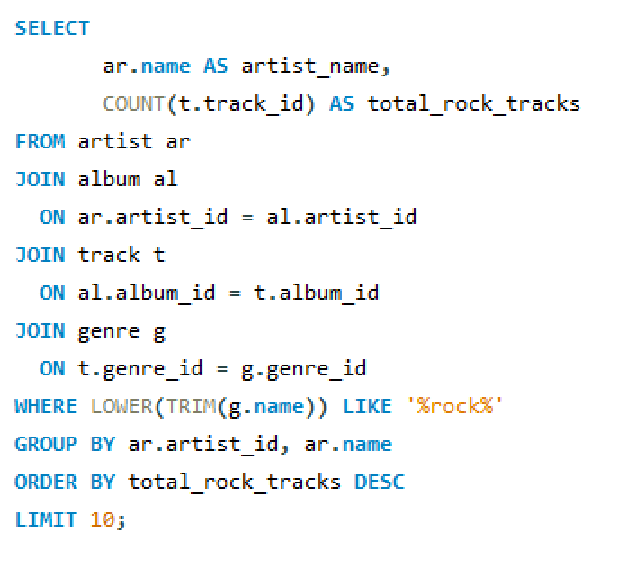
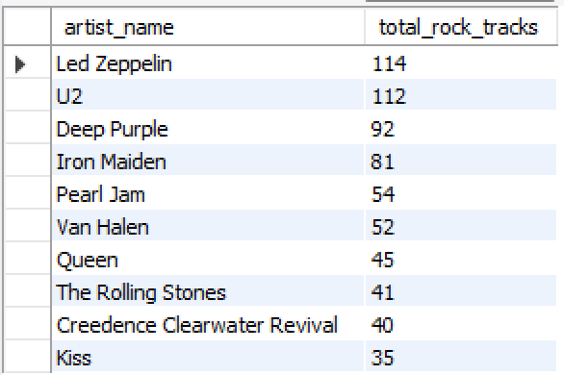
7. Let's invite the artists who have written the most rock music in our dataset. Write a query that returns the Artist name and total track count of the top 10 rock bands.

Slide 15
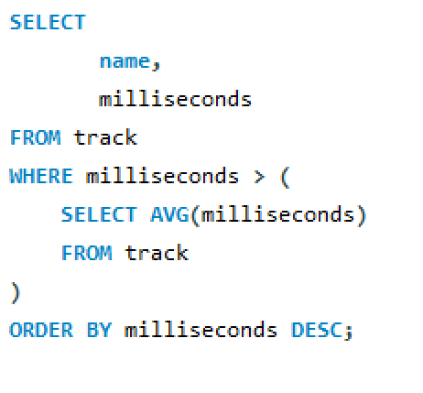
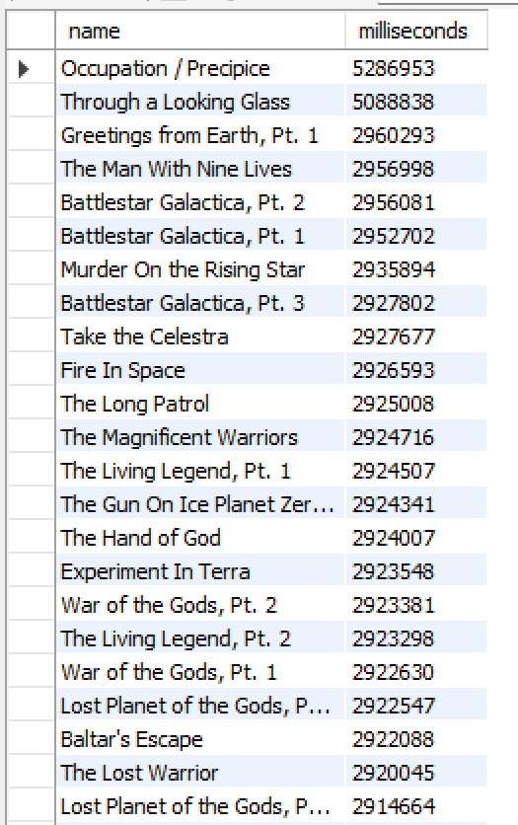
8. Return all the track names that have a song length longer than the average song length.- Return the Name and Milliseconds for each track. Order by the song length, with the longest songs listed first.

Slide 16
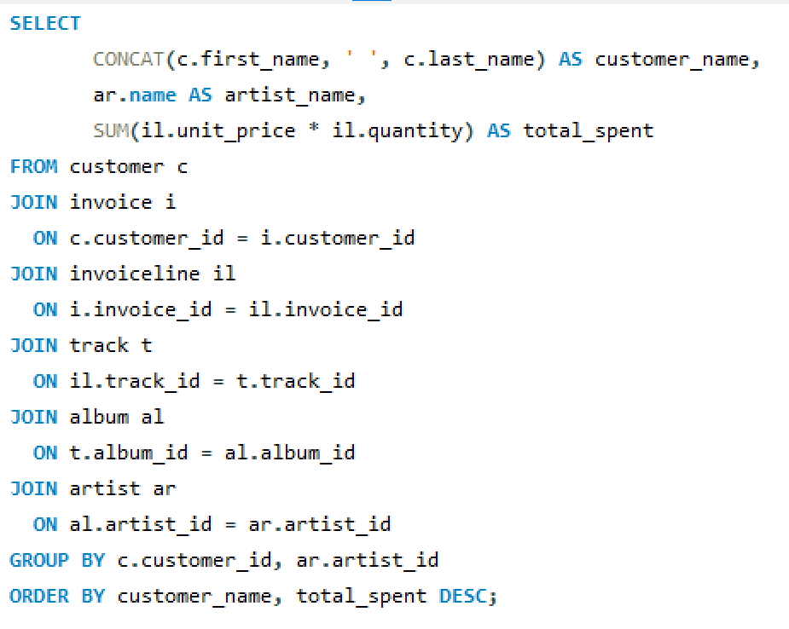
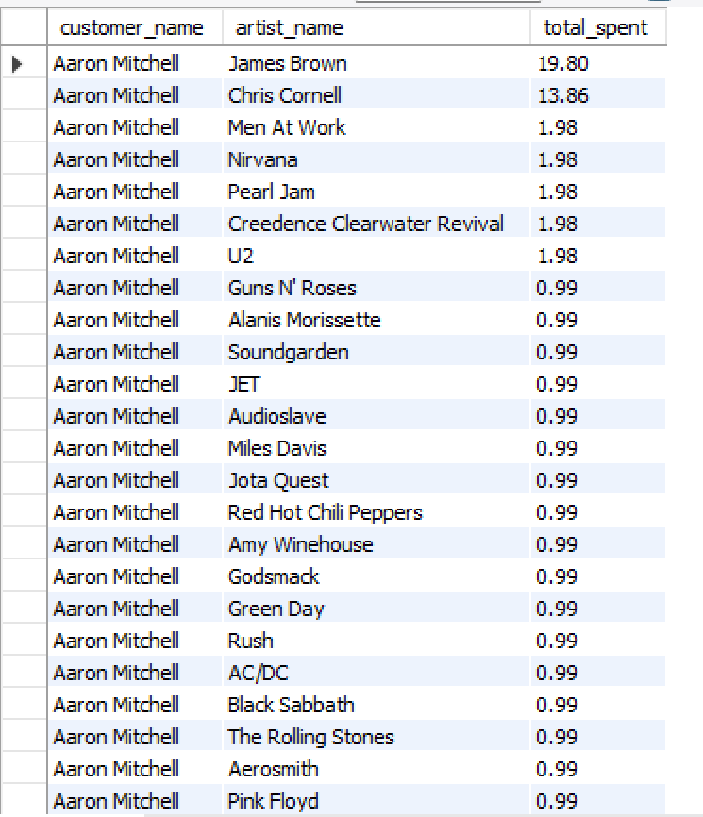
9. Find how much amount is spent by each customer on artists? Write a query to return customer name, artist name and total spent

Slide 17
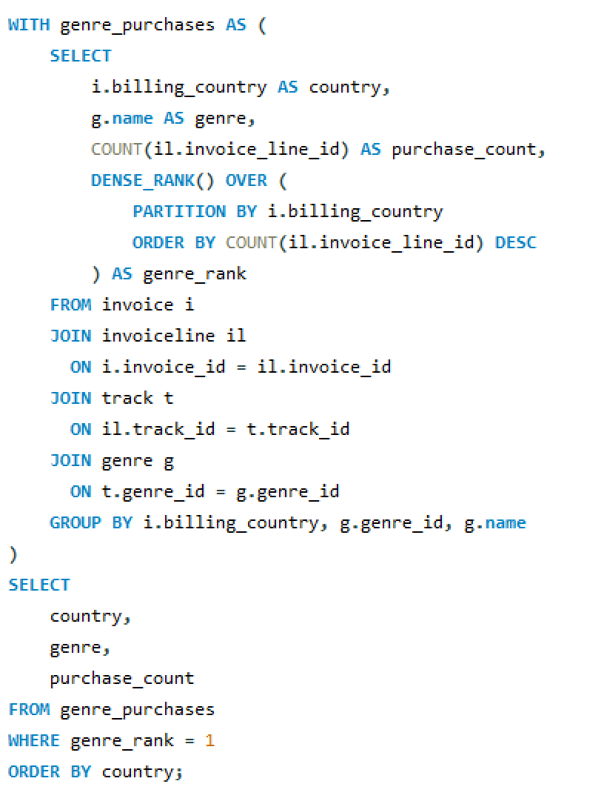
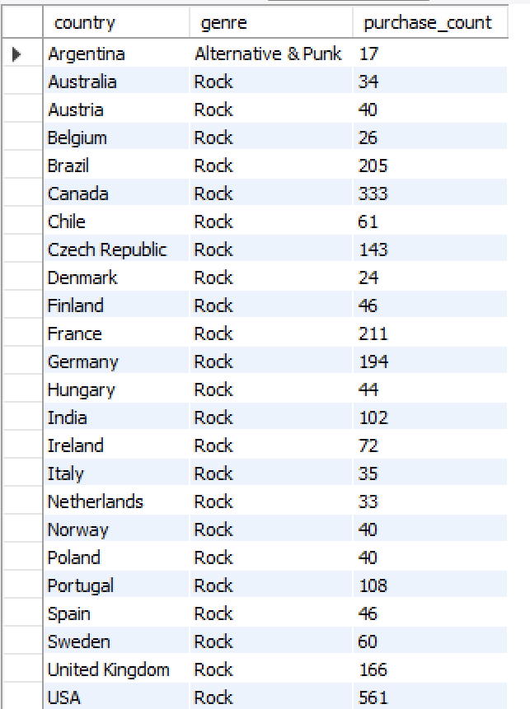
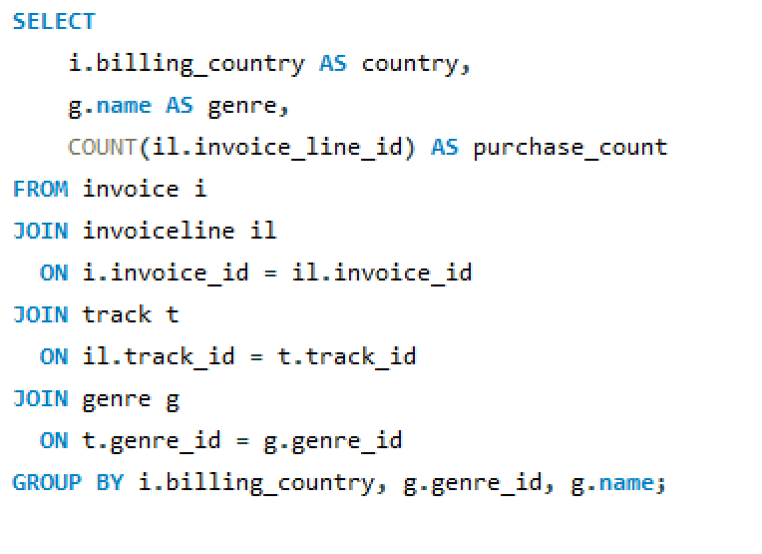
10. We want to find out the most popular music Genre for each country. We determine the most -- popular genre as the genre with the highest number of purchases. Write a query that returns each country along with the top Genre. For countries where the maximum number of purchases is shared, return all Genres

Slide 18
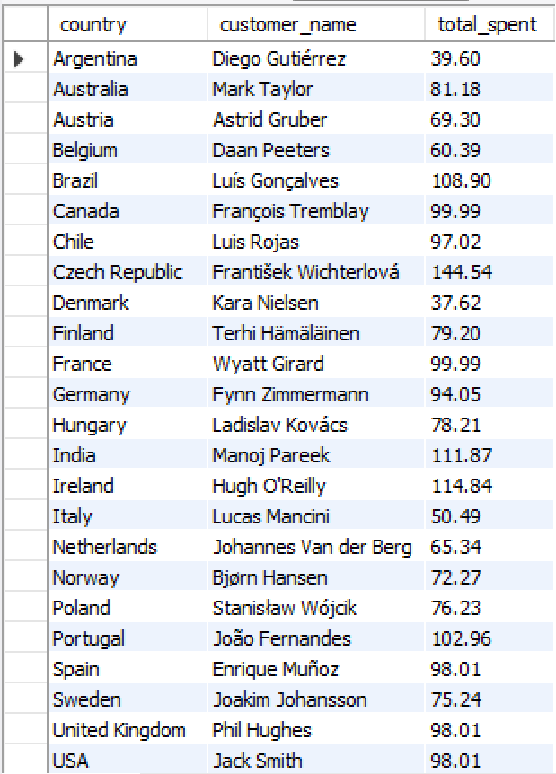
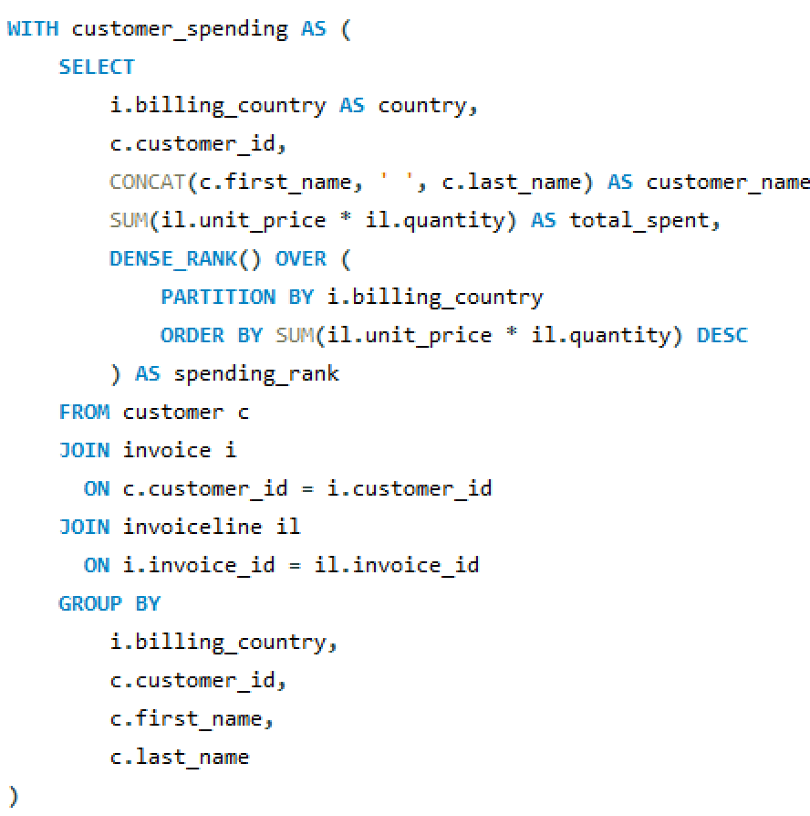
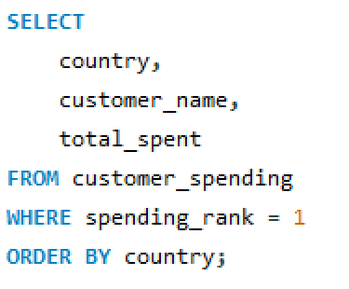
11. Write a query that determines the customer that has spent the most on music for each country. Write a query that returns the country along with the top customer and how much they spent. For countries where the top amount spent is shared, provide all customers who spent this amount

Slide 19
Final business insights and recommendations
Key Business Insights
The USA generates the highest overall revenue among all countries
India shows growing customer engagement, indicating strong potential for market expansion
Rock music emerges as the most popular genre across multiple countries
A small group of customers contributes a significant portion of total revenue
Certain cities consistently record high invoice totals, reflecting strong regional demand

Slide 20
Final business insights and recommendations
Business Recommendations
Organize promotional music events in high-revenue cities across the USA and India
Launch region-specific marketing strategies tailored to Indian customer preferences
Focus targeted campaigns on Rock genre listeners
Introduce loyalty and reward programs for high-spending customers

Slide 21
Conclusion
This project helped us understand how SQL can be used to analyze real-world business data.
By applying JOINS, AGGREGATIONS, and SUBQUERIES, we were able to extract meaningful business insights.
The analysis demonstrates how data-driven decision-making can significantly improve business strategy and performance.

Slide 22
Our Experience/Challenges working on SQL – Data Analysis Project.
Understanding complex table relationships and foreign key dependencies was challenging in the initial stages
While importing CSV data, we faced issues related to data type mismatches, NULL values, and date format errors
Writing optimized JOIN queries across multiple tables required careful planning and repeated testing
Handling aggregate functions, GROUP BY, and nested subqueries improved our logical thinking and SQL proficiency
Debugging incorrect query outputs and improving query performance strengthened our real-world data analysis confidence

Slide 23
Q&A Slide
We are happy to ANSWER your questions

Slide 24

THANK YOU

